Slide 1





DEPI
Data Analysis Graduation Project
Exoplanet Habitability Zone
The remarkable progress in space science and observational astronomy has revolutionized the search for planets beyond Earth, transforming the discovery of potentially habitable worlds into one of the most significant scientific pursuits of the 21st century. As the number of confirmed exoplanets continues to grow, identifying those with conditions suitable for sustaining life has become a major focus for astronomers and space agencies worldwide. Exploring the physical and environmental characteristics of these planets provides valuable insights into planetary formation, the possibility of extraterrestrial life, and the future of human space exploration.
.
Track
Initiative
Dataset
Date
Data Analysis
DEPI
5673 Records
July 2026
Presented by: Mohamed Esam • Nourhan Khalifa • Youssef Abduallah • Hannah Hanny • Youssef Amir
Supervised by: Eng. Mohamed Alemam
1

Slide 2



DEPI
Project Idea
Problem
Solution
Unique Value
Thousands of exoplanets have been discovered, making manual exploration and comparison increasingly difficult.
End-to-end data pipeline implemented using Microsoft Fabric and the Medallion Architecture.
Apply the complete data analytics pipeline to a large exoplanet dataset
Composite habitability metrics generated using Z-score normalization, providing deeper insights than individual planetary attributes.
Engineer composite KPIs such as Habitability Score and Planet Similarity Index using normalized astronomical features.
Planetary characteristics are distributed across multiple variables, making habitability assessment complex.
Interactive visualizations that help researchers and decision-makers identify the most promising exoplanets for future exploration and scientific studies.
Build a 6-page interactive Power BI dashboard to enable efficient exploration, comparison, and visualization of potentially habitable exoplanets.
There is no single comprehensive metric that summarizes a planet's potential habitability using multiple environmental factors.
2

Slide 3






DEI
Project Wireframe — Power BI Dashboard
The final deliverable is a 6-page interactive Power BI dashboard: “Habitable Exoplanets Discovery & Analysis Dashboard”
01
02
03
04
05
06
Executive Overview
Planet Discovery
Planet Characteristics
Star & Orbit Analysis
Habitability Assessment
Prediction & Recommendation
High-level snapshot
Total Exoplanets, Potentially Habitable Planets, Average Distance from Earth, Earth Similarity Index (ESI), Habitability Score
Discovery insights & trends , Discovery Method, Discovery by Year, Telescope Used, Number of New Discoveries, Confirmed vs Candidate Planets
Physical properties, Planet Radius, Planet Mass, Surface Gravity, Density, Planet Type, Earth Similarity Index
Host star and orbital conditions, Host Star, Temperature, Stellar Mass, Stellar Radius, Orbital Period, Distance from Star, Habitable Zone Status
Machine Learning Model, Predicted Habitability, Feature Importance, Model Accuracy, Confusion Matrix, Prediction Confidence
Life-supporting conditions, Habitability Score, Surface Temperature, Water Availability Indicator, Atmosphere Indicator, Potentially Habitable Classification
Focus on Data Visualization & User Experience: The dashboard was designed to present complex exoplanet data through intuitive layouts, interactive filters, consistent color themes, and a storytelling approach that guides users from discovery insights to habitability prediction.
3

Slide 4
DEPI
End Users + Features
Key Features
✓ Medallion Pipeline:
Primary End Users
Bronze → Silver → Gold on Microsoft Fabric with automated data transformation and validation.
Machine Learning model predicts planetary habitability using key astronomical features.
Astronomers & Space Researchers
✓ AI Prediction Model:
Analyze exoplanet data, identify potentially habitable planets, and support future space exploration missions. .
✓ Habitability Score:
0–100 composite score evaluating the potential of each exoplanet to support human life.
Space Agencies & Decision Makers
✓ Habitable Zone Detection:
Identifies whether a planet lies within its star’s habitable (Goldilocks) zone.
Use insights to prioritize promising exoplanets for observation and future exploration programs. .
✓ Earth Similarity Index (ESI):
Calculates similarity to Earth based on radius, mass, temperature, and gravity.
Students & Astronomy Enthusiasts
✓ Star Schema (Gold):
1 Fact Table + 4 Dimension Tables optimized for Power BI reporting and analytics.
Explore planetary discoveries, compare Earth-like planets, and understand the factors affecting habitability.
✓ 7-Page Dashboard:
Multi-page Power BI dashboard with KPIs, slicers, maps, and dynamic visualizations for planet exploration.
4

Slide 5
DEPI
Data Structure
Dataset Overview
Medallion Architecture — Data Flow
Source
NASA Exoplanet Watch Dataset and Kaggle
BRONZE
Data Type
Synthetic CSV
Bronze Layer - Raw ingestion, no transforms → new_cleaned_exoplanets.csv, new_parallax.csv
Rows
5678 (full dataset)
▼
Raw Columns
19 columns
SILVER
Silver Layer - Physics-based cleaning + imputation → Data_Cleaned_Silver_layer.csv
Engineered Cols
6 KPIs added in Silver layer (total 25 cols)
Nulls
about 30% of the raw data and handled with scientific relations and equations
▼
GOLD
Gold Layer - Star Schema (1 Fact + 4 Dimension tables) → Data_Gold_Layer.csv / xIsx, Power BI ready
5

Slide 6
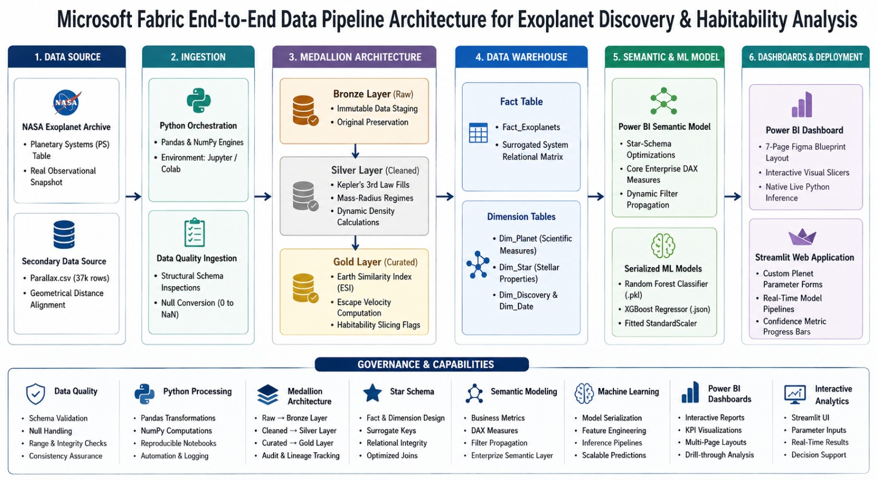
DEPI
ARCHITECTURE
Power BI Dashboard
7

Slide 7
DEPI
Programming Languages + Frameworks
Programming Languages
Cloud & Platforms
• Python — primary language for all Data Engineering and ML ﻿﻿• DAX - Power BI KPI calculations & measures
• NASA Exoplanet Archive - primary data source ﻿﻿• Kaggle - source of ExoHab (NASA/HWC) for the ML model ﻿﻿• Power BI - 7-page interactive dashboard ﻿﻿• Figma — dashboard design
Frameworks & Libraries
Storage Formats
• pandas/ NumPy - data cleaning & scientific calculations ﻿﻿ • scikit-learn - RandomForestClassifier, StandardScaler • ﻿﻿XGBoost — Earth Similarity Regressor ﻿﻿ • imbalanced-learn (SMOTE) - handling class imbalance ﻿﻿ • joblib — model serialization ﻿﻿ • Streamlit — the demo app ﻿﻿ • kagglehub - downloading the ExoHabX dataset
• CSV / Excel — used across the whole pipeline (Bronze/Silver/Gold) ﻿﻿• Star Schema - Fact table + 4 Dimension tables ﻿﻿• Direct import - Power BI connects directly to the Gold/Enriched CSV files
8

Slide 8
DEPI
Live Application + Test — Power BI & ML Models
Status: Production Ready
Dashboard Pages Overview
Power BI Dashboard - 7 Pages
P1
Exoplanet — Cover Page
The dashboard connects via Direct Import to the Gold/Enriched CSV files (Data_Gold _Layer _Enriched.csv). It features KPI cards, scatter plots, histograms, bar charts, a donut chart, a correlation heatmap, and a Python visual (on the Al Model page) with interactive slicers on every analytical page
Branding, mission tagline
P2
Description
Mission statement text box
P3
Overview
KPI cards, cumulative-discoveries chart, donut, histogram
✓
Data Validation:
P4
Habitability
Core physical columns (Radius, Mass, Density, Temperature, Flux) confirmed with zero remaining nulls after the Silver-layer cleaning pass
KPI cards, Kepler's Law scatter, Mass vs Radius, eccentricity histogram, bar chart
✓
P5
Star Systems
Pipeline Testing:
Bronze → Silver → Gold run end-to-end on ~5,394-5,878 rows (varies by snapshot, since NASA's source updates daily) - no data loss
KPI cards, H-R diagram, scatter plot, bar chart, correlation heatmap
P6
Planet Explorer
✓
ML Model Testing:
KPI cards, Goldilocks-zone scatter, ESI histogram, Top-10 bar chart
Habitability Classifier (Random Forest) - Test Accuracy 99.06%, Class 1 (Habitable) Recall 0.60; Earth Similarity Regressor (XGBoost) - R2= 0.87, RMSE = 4.58, trained on the ExoHabX (NASA/HWC) dataset
P7
Al Model
6 live slicers + Python visual (classifier & ESI regressor output)
12/05/2026
9

Slide 9
DEPI
Deliverables
01
Data Pipeline
03
ML Model
• Bronze layer — raw CSV ( 6,128 rows, 19 cols), no transforms ﻿﻿ • Silver layer — cleaned SV, physics-based imputation (5,394 rows, nulls resolved) ﻿﻿ • Gold layer - Star Schema, CSV/Excel (1 Fact + 4 Dimension tables)
• 2 models: Habitability Classifier (Random Forest) + Earth Similarity Regressor (XGBoost) ﻿﻿ • Trained on ExoHabX (NASA/HWC) - 5,326 planets, 25 habitable (ESI ≥ 80) ﻿﻿ • Test results: Classifier accuracy 99.06% (Class 1 recall 0.60); Regressor R2 = 0.87 ﻿﻿ • Deployed via a Streamlit app and a live Python visual on the dashboard's Al Model page
02
EDA & Power BI Dashboard
04
Documentation
• 7-page interactive dashboard ﻿﻿• KPI cards, scatter plots, histograms, donut/bar charts, correlation heatmap ﻿﻿• Direct CSV import
• Chapter 1: Project Overview & Data Source ﻿﻿ • Chapter 2: Technical Architecture (Medallion + Star Schema) ﻿﻿ • Chapter 3: Data Engineering & Analysis (Cleaning + Engineering) ﻿﻿ • Chapter 4: Machine Learning ﻿﻿ • Chapter 5: Dashboard & Visualization
12/05/2026
10

Slide 10
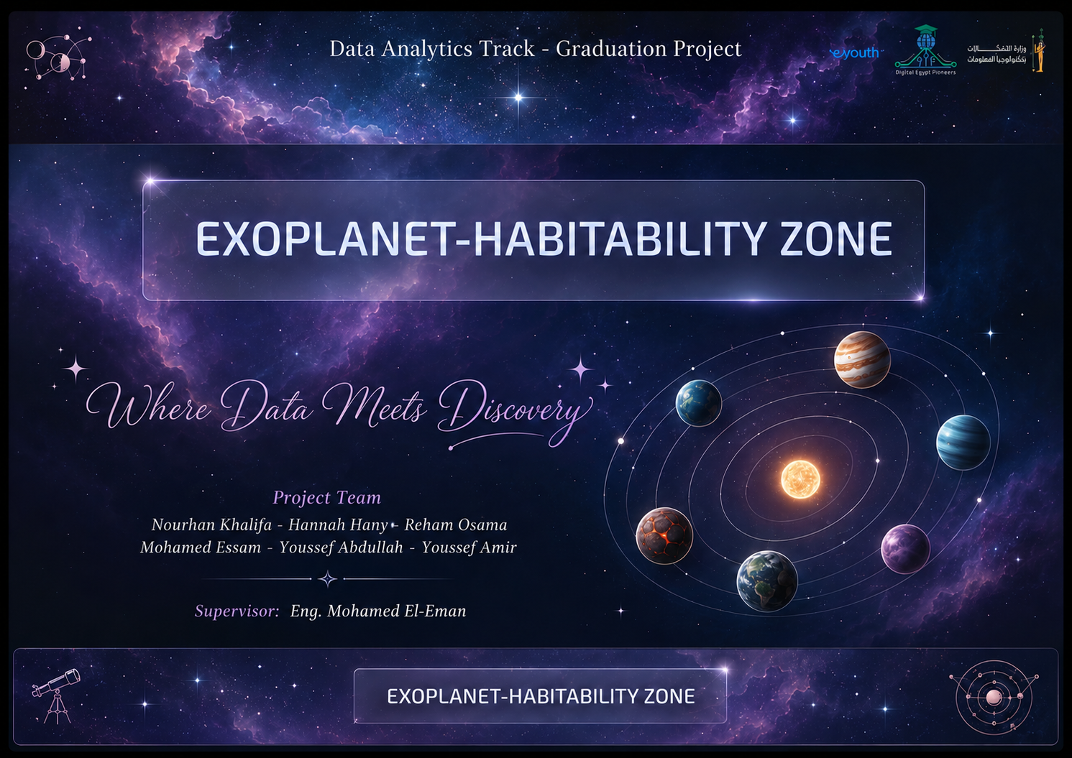
DEPI
Power BI Dashboard - landing page
11

Slide 11
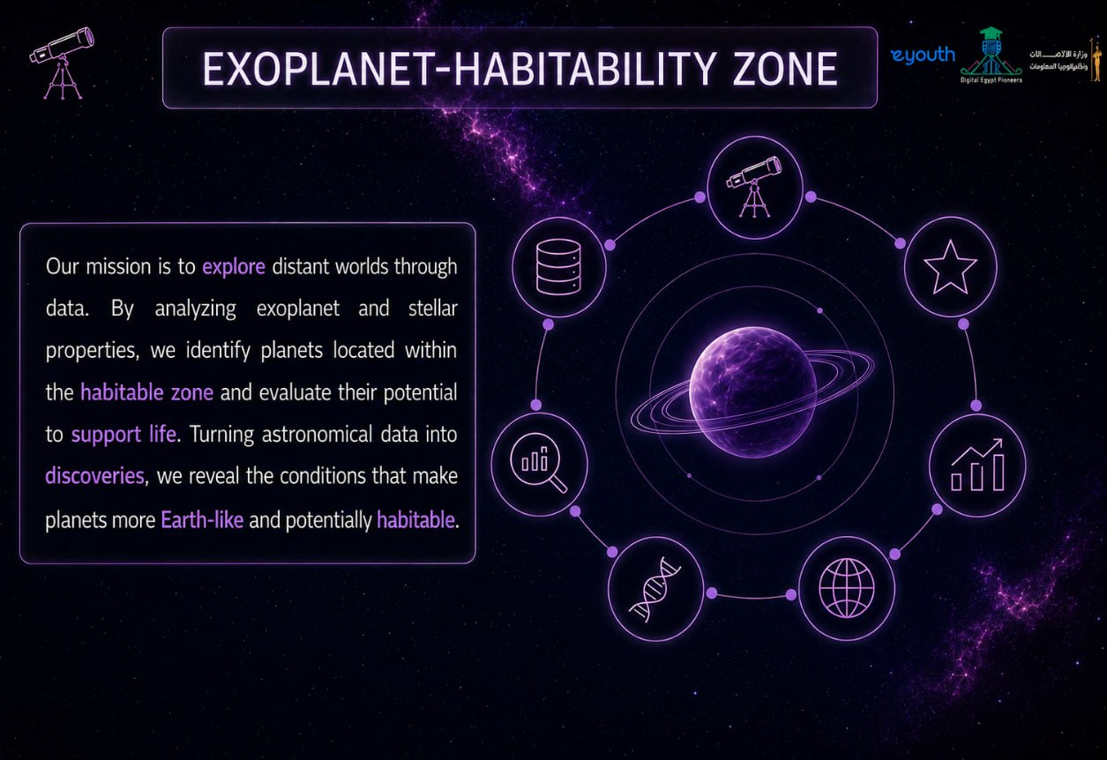
DEPI
Power BI Dashboard – Description page
12

Slide 12
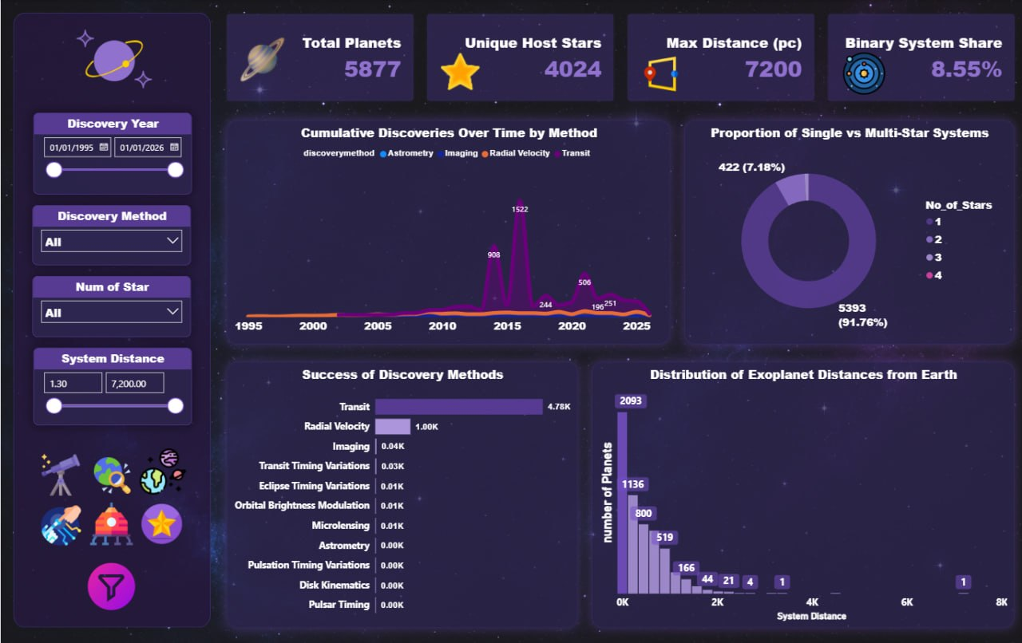
DEPI
Power BI Dashboard
P.1
Every discovery brings us closer. From distant star systems to nearby worlds, each detected exoplanet helps us better understand the diversity of our galaxy.
13

Slide 13
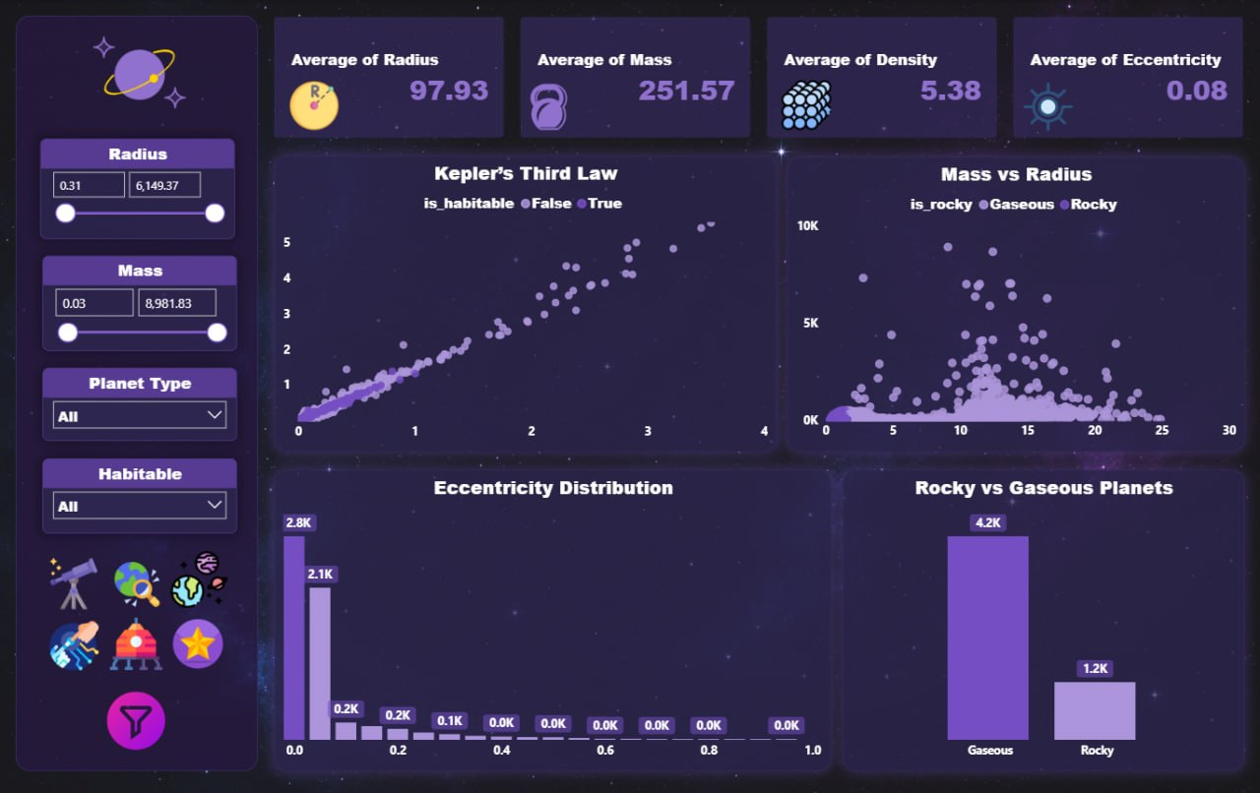
DEPI
Power BI Dashboard
P.2
Every planet has its own story. Our analysis reveals how planetary characteristics shape composition, habitability, and the diversity of worlds beyond our solar system.
12/05/2026
14

Slide 14
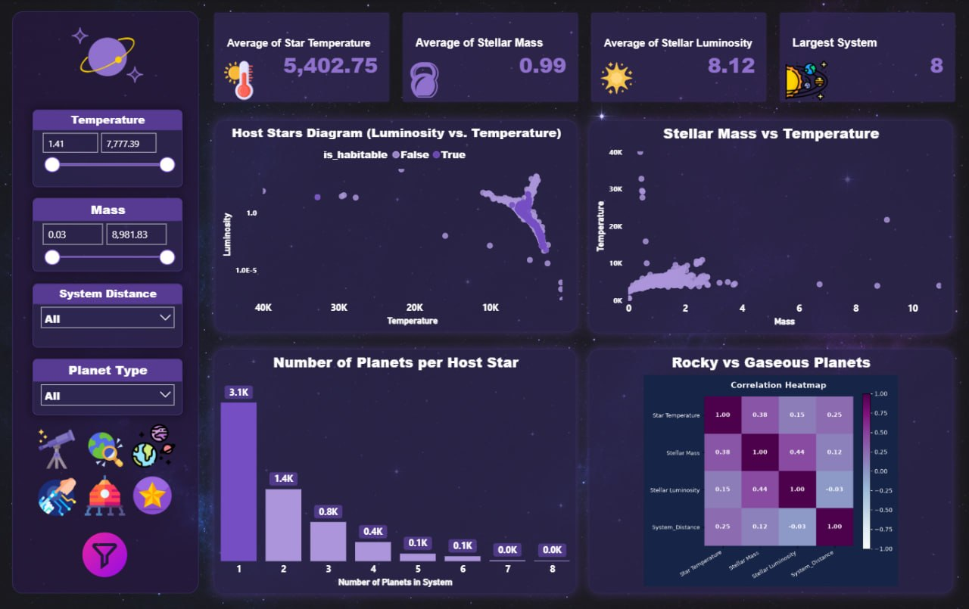
DEPI
Power BI Dashboard
P.3
The stars hold the key to new worlds. Understanding stellar characteristics helps explain the evolution, structure, and habitability of planetary systems.
12/05/2026
15

Slide 15
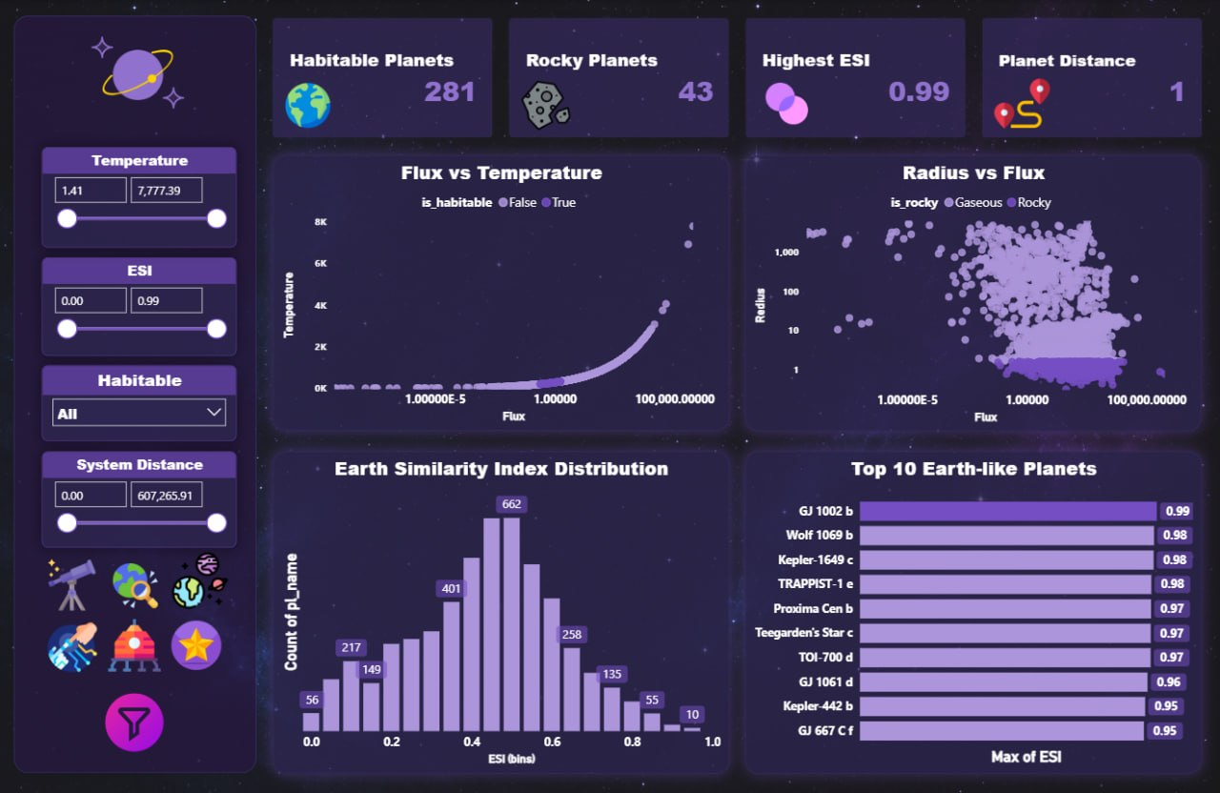
DEPI
Power BI Dashboard
P.4
Not every planet can be called home. Our analysis identifies the planetary characteristics that increase the potential for Earth-like conditions and habitability.
16

Slide 16
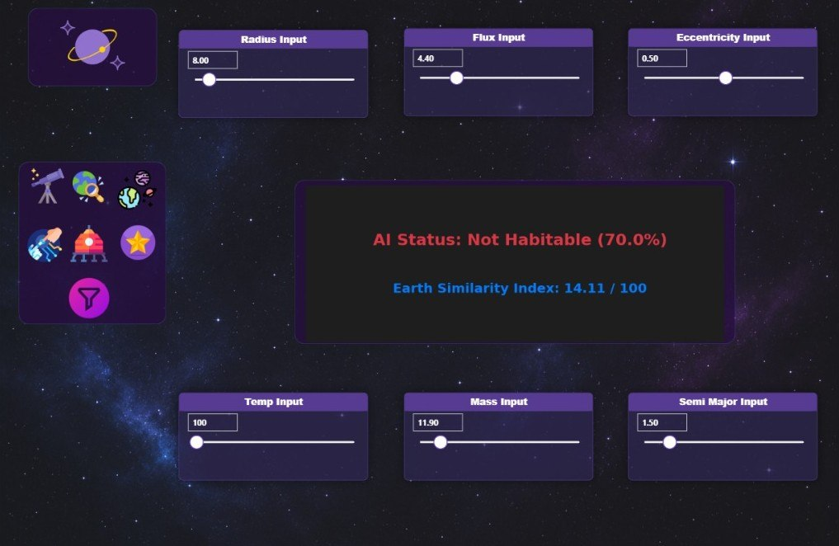
DEPI
Power BI Dashboard
P.5
Predicting tomorrow's discoveries today. Our AI model evaluates planetary characteristics to estimate habitability and Earth Similarity Index (ESI).
Power BI Dashboard
17

Slide 17
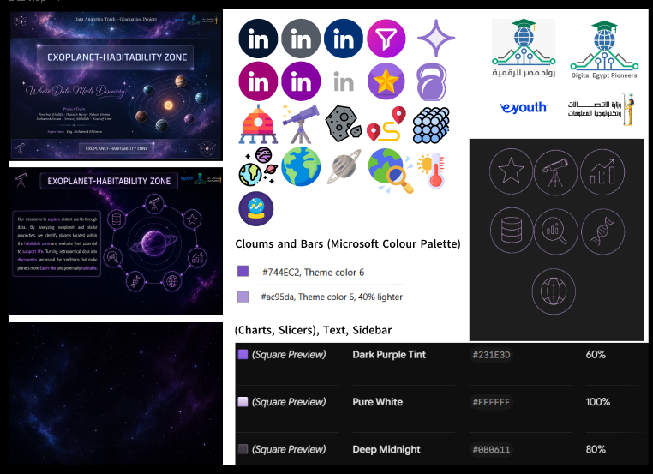
DEPI
Figma Design
Power BI Dashboard
Power Bi design:
• In the main pages, we used a galaxy-inspired design combined with space-themed icons and illustrations. • In the AI analysis page, we used modern AI elements with a futuristic interface to visualize planet habitability prediction.
18

Slide 18
DEPI
Project Team + Roles
Team of 6 — Digital Egypt Pioneers Initiative | Data Analysis Track
Nourhan Khalifa
Mohamed Essam
• EDA Structure & Figma
• Data cleaning
• Documentation
•AI Model
Hannah Hany
• Power bi & Figma
• Presentation design & structure
Youssef Amir
Youssef Abdullah
• Power BI
• Data cleaning
• Leader responsibilities
• Fabric
12/05/2026
EYOUth.
19

Slide 19
DEPI
Thank You!
Exoplanet Habitability Zone
— DEPI Data Analysis Track
Questions & Feedback Welcome
Hannah Hanny
Mohamed Essam
Nourhan Khalifa
Youssef Amir
Reham Osama
Youssef Abdullah
Built with: • Python • Figma • Power BI
Supervised by: Eng. Mohamed El Emam
12/05/2026

